Slide 1
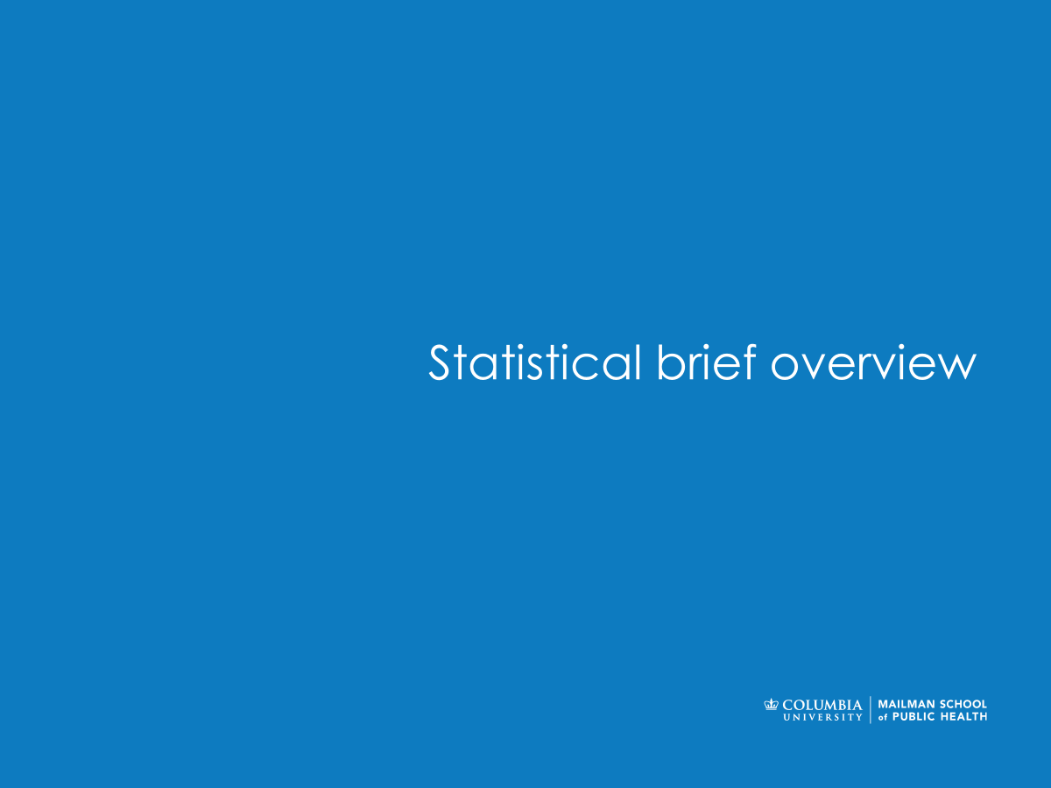

Computing in Context: Fall 2024
Lecture 5 | Intro to data visualization
Statistical brief overview
Dr Sarah Ashcroft-Jones | Mailman School of Public Health

Slide 2
Data visualization
Making numbers meaningful

Slide 3
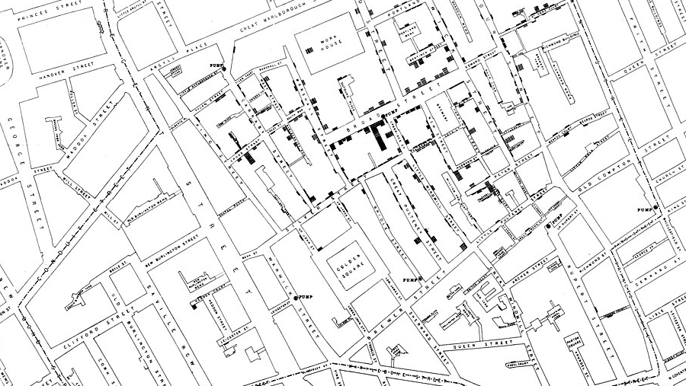

Notes:
John Snow 1854
1854. London. Cholera strikes. In just 10 days, over 500 people have died in one neighborhood. The mysterious cluster of deaths is especially terrifying because no one understands the source.
No one besides John Snow, an epidemiologist who believed that the water supply was spreading the disease. He plotted every death on a map with ingenious mapped bar charts (see above) and was able to show that the closer to the Broad Street water pump he plotted, the greater the number of deaths.

Slide 4
“The greatest value of a picture is when it forces us to notice what we never expected to see.”
John Tukey, 1977

Slide 5
What is data visualization?
The process of representing data graphically
It helps to make data understandable and actionable
Many examples including bar charts, line charts, and scatter plots.

Slide 6
It’s all about insight …
Answers to concrete questions about a dataset (confirmatory)
or
Facts about a given problem we were not aware of (exploratory).

Slide 7
Why is it important?
Simplifies complex data
Enhances decision-making by revealing insights
Helps communicate findings effectively to non-technical audiences

Slide 8
Choosing the right visualization
What’s the purpose of your visualization?
Is it for comparison, trends, relationships, or distribution?
Match data to the chart type:
e.g. Time series → Line chart
e.g. Comparison → Bar chart

Slide 9
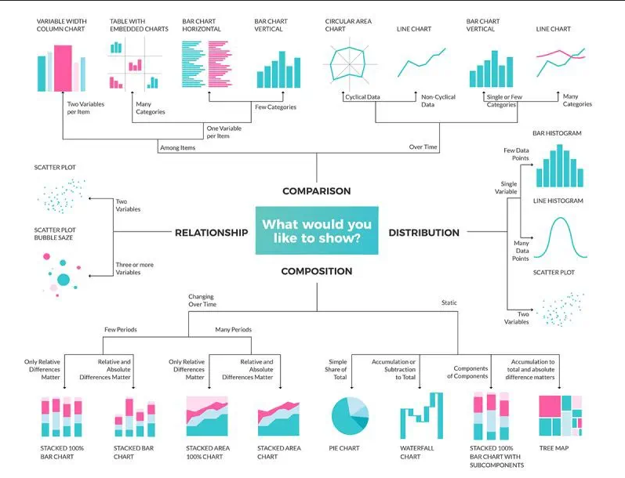

Slide 10
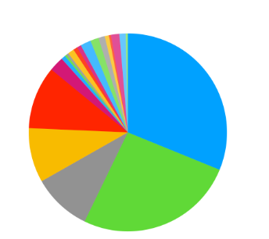
A personal note on pie charts

Slide 11
A note on pie charts - don’t

Slide 12
Best practices
Simplicity: Less is more—avoid information overload
Consistency: Use the same colors and styles across visualizations
Clarity: Include clear titles, axis labels, and legends
Color: Use meaningful colors (e.g., red for losses, green for gains)

Slide 13
Color – a note
Accessibility in data visualization
Check your color palettes – be mindful of colorblindness
Use icons and symbols in addition to color
Use direct labels
https://www.datylon.com/blog/data-visualization-for-colorblind-readers

Slide 14


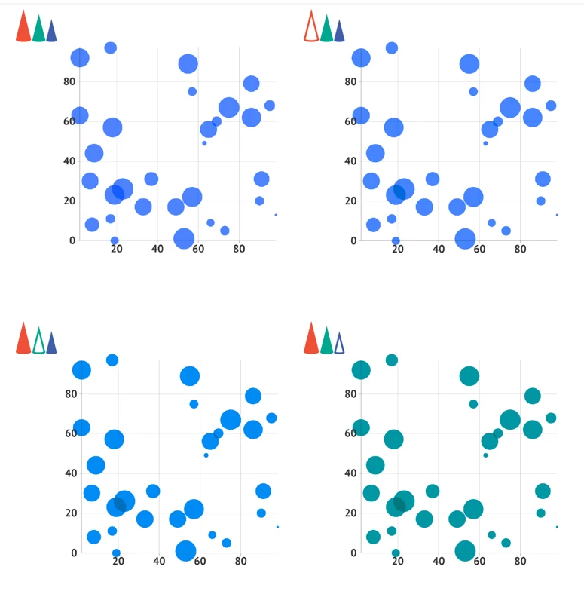
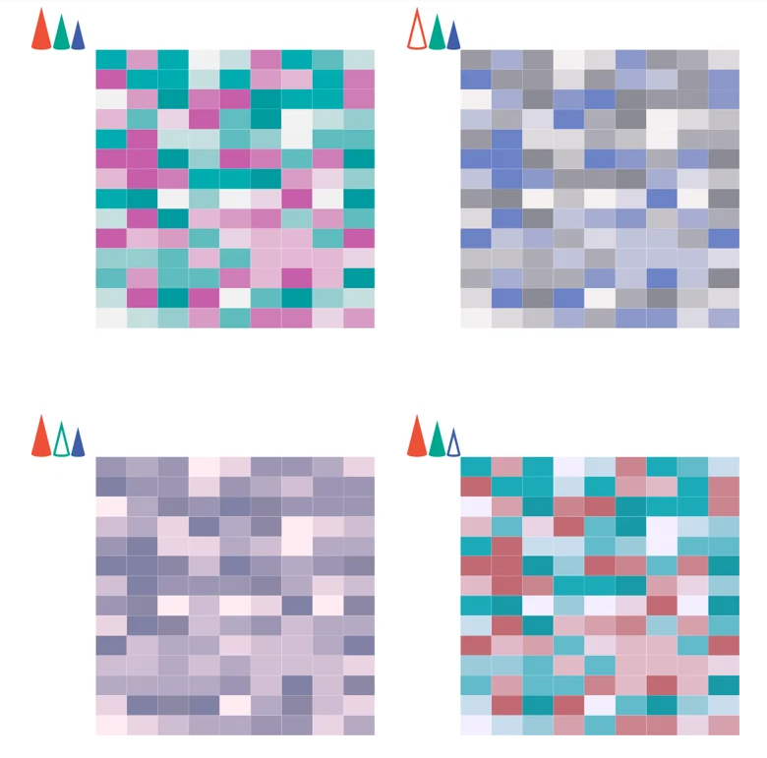
Color – a note
https://www.datylon.com/blog/data-visualization-for-colorblind-readers

Slide 15
Responsible data visualization
The good, the bad, and the downright dangerous

Slide 16
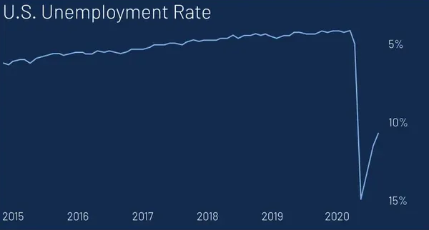

Slide 17
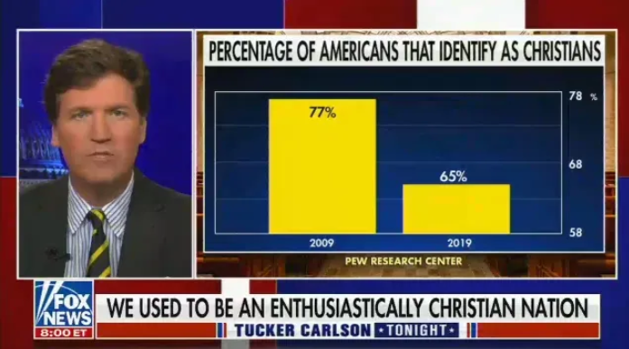

Slide 18
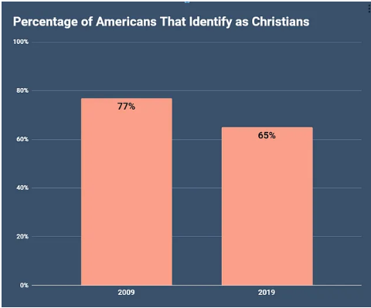

Slide 19
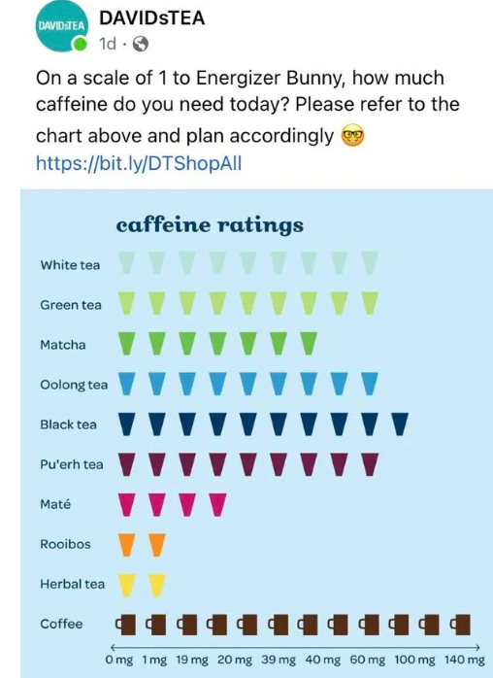

Slide 20
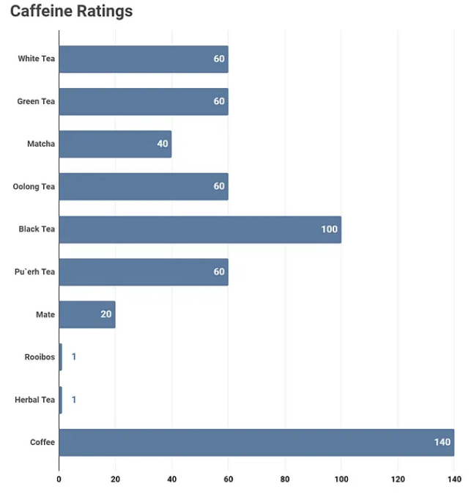

Slide 21
Things to avoid
Misleading Axes: Starting axes at non-zero values can distort
Overloading Data: Too much information makes it unreadable
Inconsistent Design: Switching colors or styles confuses viewers

Slide 22
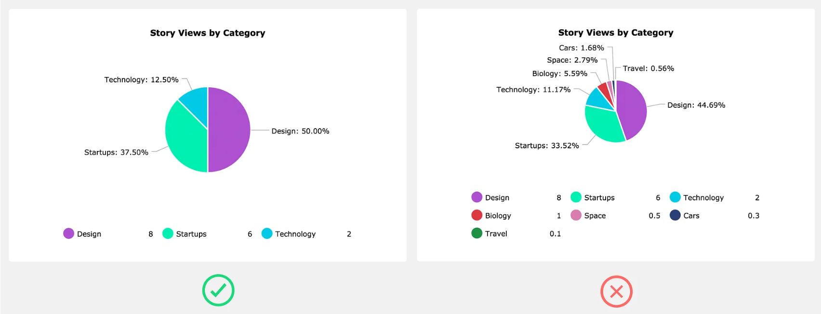
This not that…

Slide 23
Or just don’t …

Slide 24
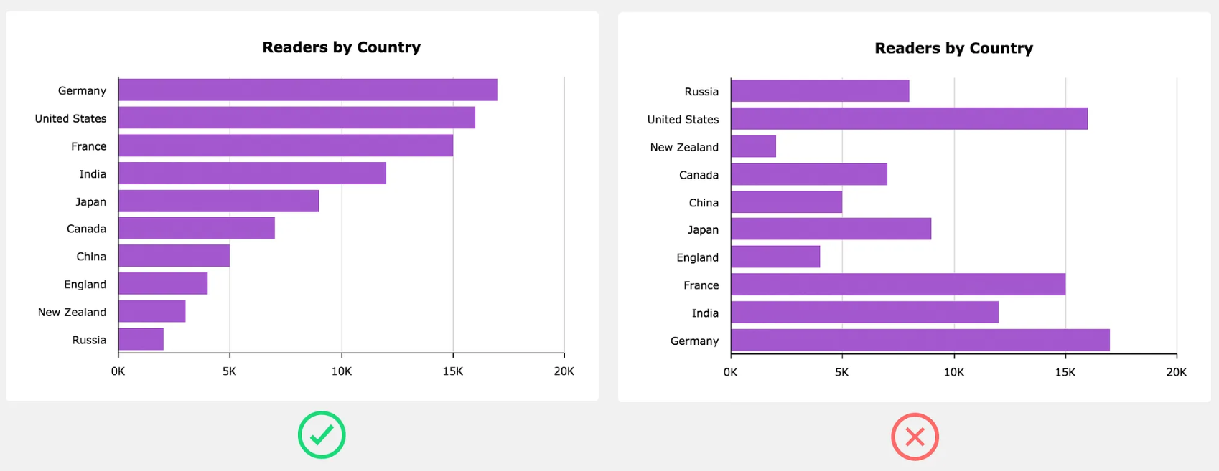
This not that…

Slide 25
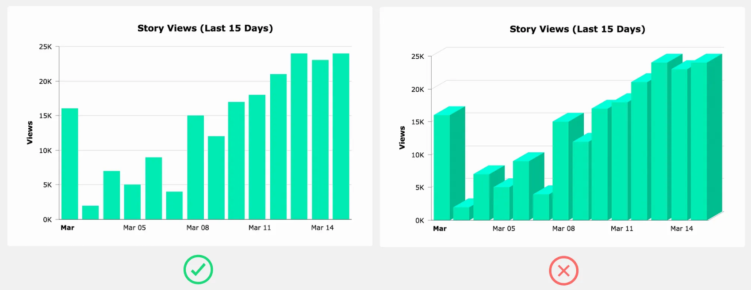
This not that…

Slide 26
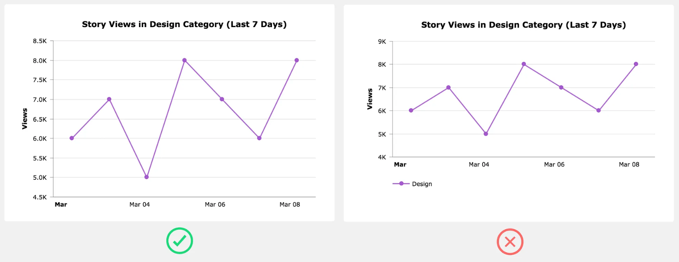
This not that…

Slide 27
Data storytelling
Data visualization at it’s best

Slide 28
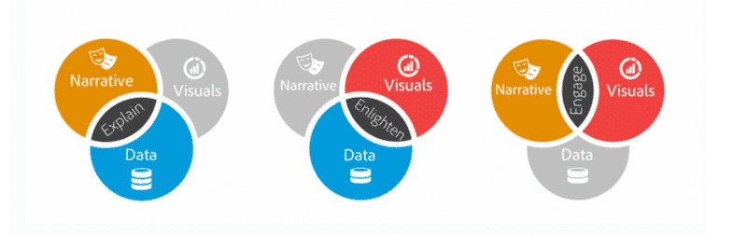

Slide 29
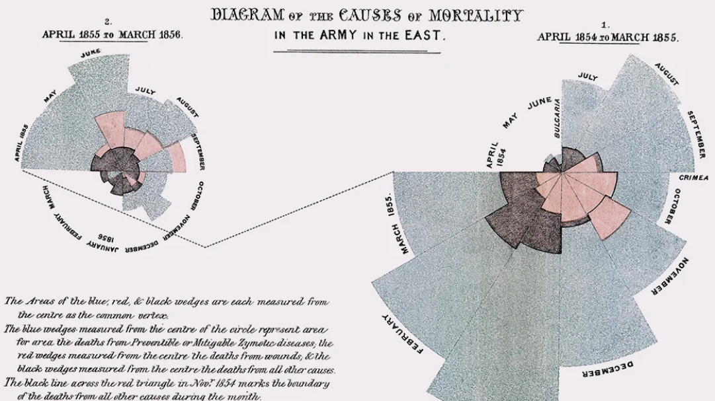
Notes:
1855. The Crimea. Britain is fighting a battle with both Russia and disease. As a nurse, how do you convince an army to invest in hospitals and healthcare instead of guns and ammunition?
Florence Nightingale told her story with data by showing the staggering amount of deaths due to preventable disease (shown in blue/grey). This visualization helped convince the British army to make sanitation a priority, saving lives in the process.

Slide 31
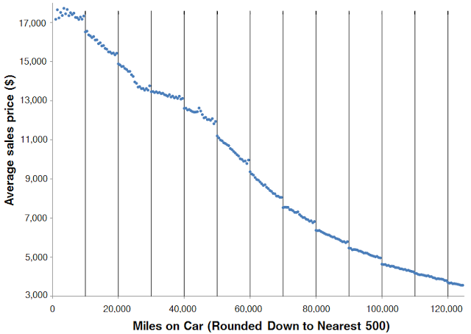

Slide 32
“bad data viz” game
Statistical brief overview
Dr Sarah Ashcroft-Jones | Mailman School of Public Health

Slide 33
“Do no harm” discussion
Statistical brief overview
Dr Sarah Ashcroft-Jones | Mailman School of Public Health

Slide 34
Questions?
Project memo due tonight
Any panic – ask now!
Statistical brief overview
Dr Sarah Ashcroft-Jones | Mailman School of Public Health

